Slide 1


Virginia’s Trout Program
Mike Bednarski
Chief of Fisheries

Slide 2
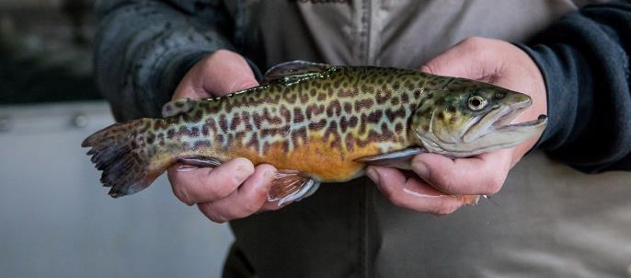
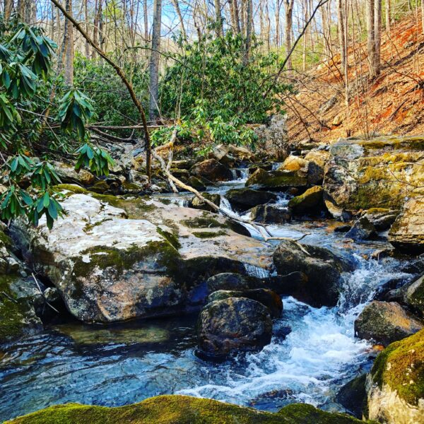
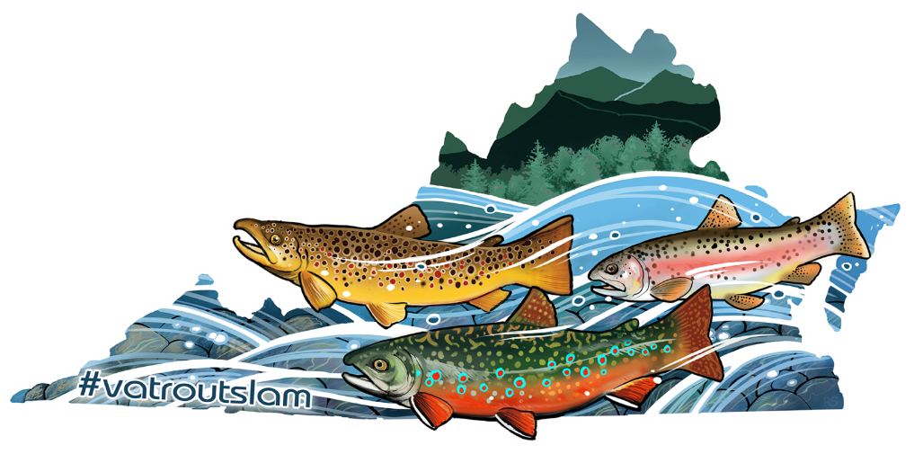
Cold Water Streams
Trout streams
~3500 miles of stream
18.8% of All Angler Effort
$107 Million in Economic Impact

Slide 3
Trout Program
Wild and stocked populations
Wild in 3,000 miles over
700 streams
Stocked in 600 miles of stream,
various small lakes
Governed by management plans
Wild
Stocked
Statewide – 6 fish limit, 7” min

Slide 4
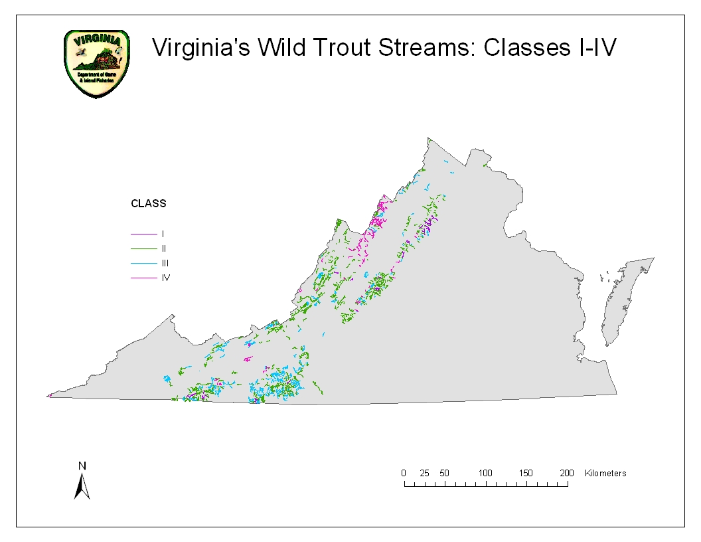
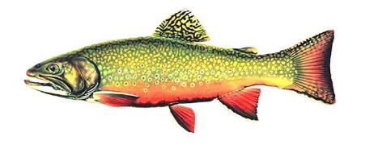
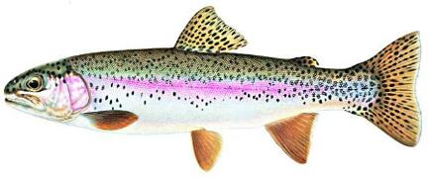
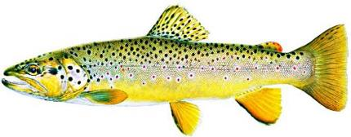
3,000+ miles
700+ streams
Notes:
So, Virginia has significant wild trout resources, and they are important to our anglers and wildlife enthusiasts. Wild Brook, Rainbow, and Brown Trout are all found in Virginia. Over 700 streams make up 3000 plus miles of wild trout streams. It’s hard to determine the number of anglers that fish for wild trout due to the trout license only being required for stocked trout……but a conservative estimate is about 60K, so it’s a fairly important resource……DGIF has a long history of wild trout management, and we have been progressive in many ways. However, we needed a way to communicate this and to formalize the Department’s wild trout program. That is what has led us to develop our current plan that includes goals/objectives/strategies.

Slide 5
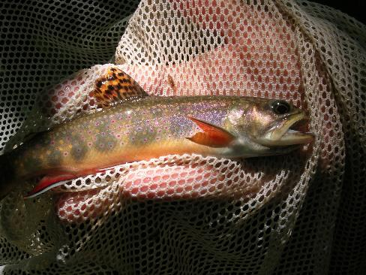
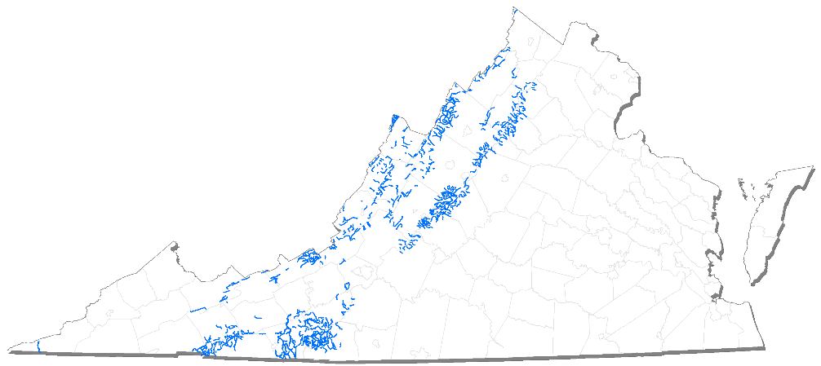
Wild Brook Trout
Notes:
Currently wild brook trout inhabit 614 individual streams stretching over 2000 miles through western and southwestern VA
Many of the populations in southwestern VA are considered Southern Appalachian BKT Populations as their genetics are different from the northern strain.
And we do have both Allopatric and Sympatric populations of BKT throughout the western part of the state.

Slide 6
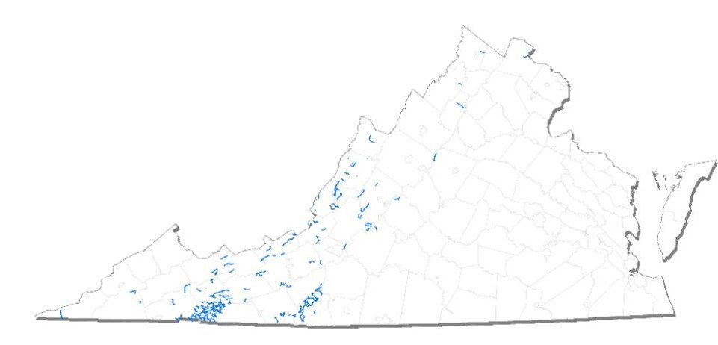
Rainbow Trout
Rainbow Trout may have been stocked in Virginia as early as the 1920’s
US FWS records indicate they were released in SNP in 1943
Currently wild rainbow trout are in 163 streams over 700 miles
Notes:
Rainbow Trout populations are found in freestone streams, spring creeks, and in coldwater tailwaters downstream of large reservoirs. Rainbow Trout eat a wide variety of prey, including insects, crustaceans, mollusks, and small fish.
Currently wild rainbow trout are found in 163 streams stretching over 700 miles

Slide 7
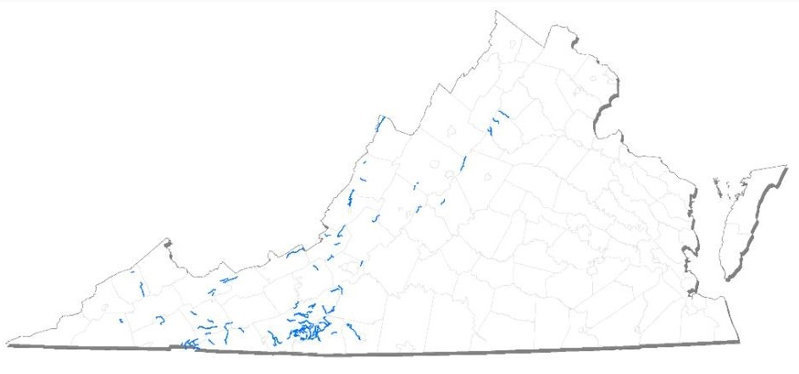
Brown Trout
Brown Trout first arrived in the US in 1883 as eggs from Germany
They were first stocked in Virginia in 1961.
Currently 92 streams (~600 miles) containing wild Brown Trout
Notes:
Brown Trout first arrived in the US in 1883 as eggs from Germany where they are native to Europe.
They were first stocked in Virginia in 1961.
Slide 12:
Brown Trout prefer larger, lower-gradient streams and can tolerate warmer water temperatures than Brook or Rainbow Trout.
Brown trout are fall Spawners similar to Brook Trout
There are currently 92 streams (⁓600 miles) containing wild Brown Trout in the Commonwealth

Slide 8
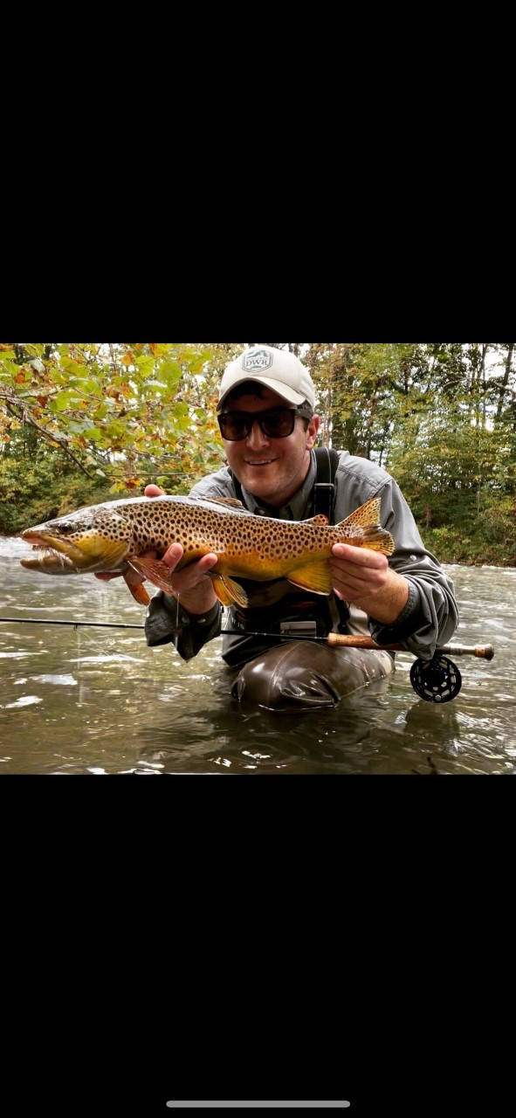
Brown Trout
Brown Trout first arrived in the US in 1883 as eggs from Germany
They were first stocked in Virginia in 1961.
Currently 92 streams (~600 miles) containing wild Brown Trout
Notes:
Brown Trout first arrived in the US in 1883 as eggs from Germany where they are native to Europe.
They were first stocked in Virginia in 1961.
Slide 12:
Brown Trout prefer larger, lower-gradient streams and can tolerate warmer water temperatures than Brook or Rainbow Trout.
Brown trout are fall Spawners similar to Brook Trout
There are currently 92 streams (⁓600 miles) containing wild Brown Trout in the Commonwealth

Slide 9
User Base – Wild Trout Angler – 5% of anglers
44 y/0 White male, college education, suburban or rural
9% Female, 6% people of color, 6% urban
Barrier to fishing -
1) Work commitments
2) Family commitments
3) Other activities
Performance –
Highest – 1) Information on regulations
2) Info on consumption advisories
Lowest – 1) Stocking warmwater fish
2) working with private landowners to provide access

Slide 10
Wild Trout Management Plan (2019-2028)
Comprehensive plan for managing wild trout
Stakeholders: National Forest, Shenandoah National Park, Blue Ridge Parkway, Virginia DCR, Virginia Chapter TU
Considers current status, major threats, and current initiatives

Slide 11
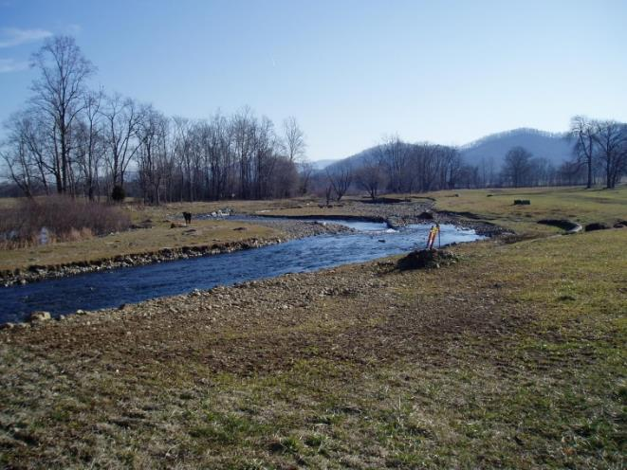
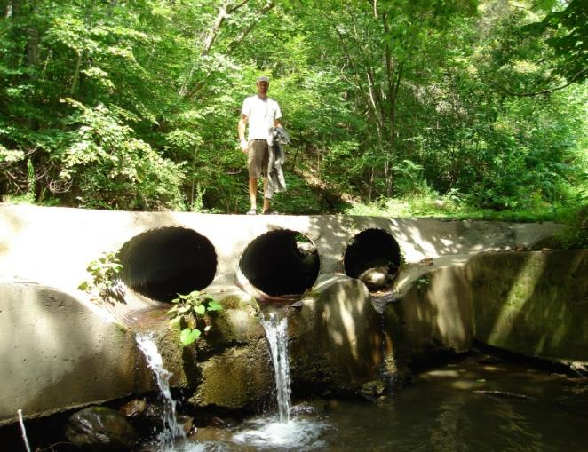
The Plan Identified these Threats to Wild Trout Populations
Notes:
These are the current threats to wild trout populations identified by the DWR, Stakeholders and from public comments.

Slide 12
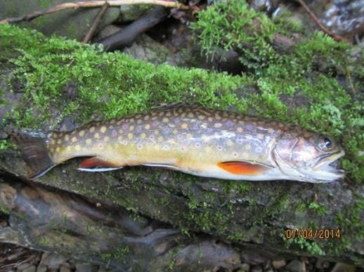
Issues Listed in the WTMP
Determining the Status of Wild Trout Stocks
Introduction of Non-Native Aquatic Species
Habitat Quality and Quantity
Brook Trout Genetics
Expand the Spatial Distribution of Wild Trout
Angling for Wild Trout
Stocking Hatchery Trout in Wild Brook Trout Waters
Connectivity
Fish Health
Marketing, Outreach, Education
Long-term Financial Support for Wild Trout
Notes:
Then we come to the “meat” of the Wild Trout Management Plan. 11 Main Issue Areas determined by DGIF Team and Key Stakeholder Group. I will run through these one by one in a second…………mentioning a few strategies for each

Slide 13
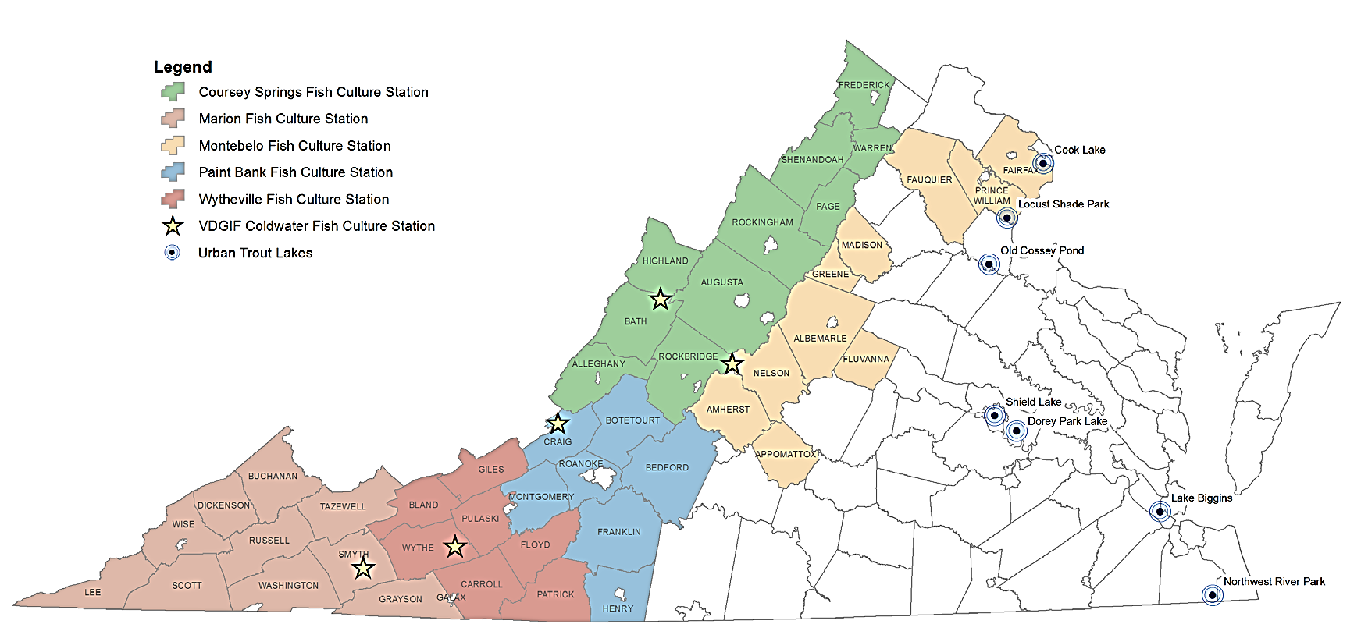
DWR Trout Production and Stocking
Five Coldwater Hatcheries
Stock 1 million: brown, brook and
rainbow trout per year
Nearly 200 waters stocked
  1,350 stocking trips per year
  140,000 miles driven
Provide services for 100K anglers
Put and Take fisheries
Fee Areas: 3
Urban Waters: 7

Slide 14
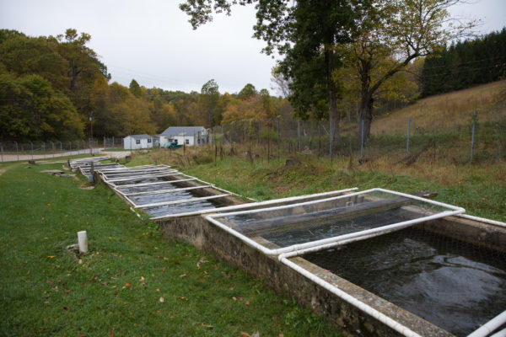
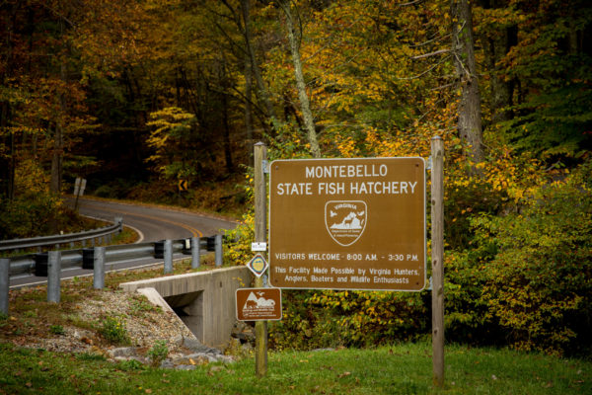
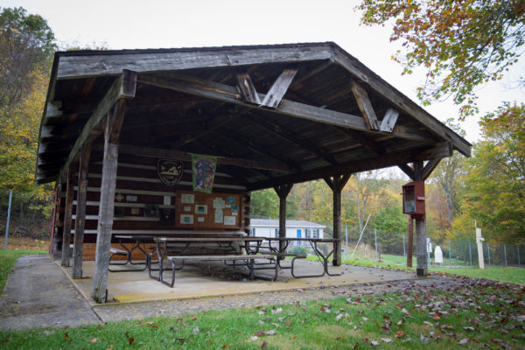
Montebello
No Eggs
Brooks/browns/rainbows
125K Trout/year
Stock 23 water bodies

Slide 15
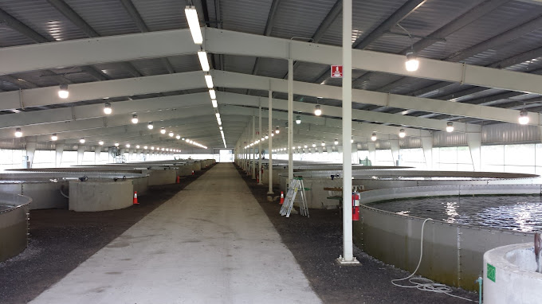
Coursey Springs
No Eggs
Brooks/browns/rainbows
180K lbs Trout produced
Stock 72 water bodies, 10 counties

Slide 16
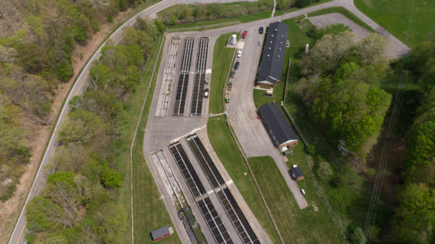
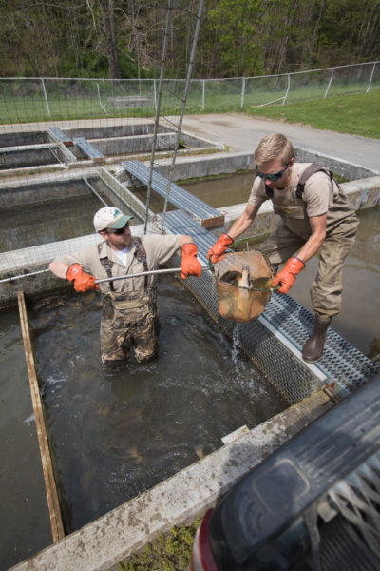
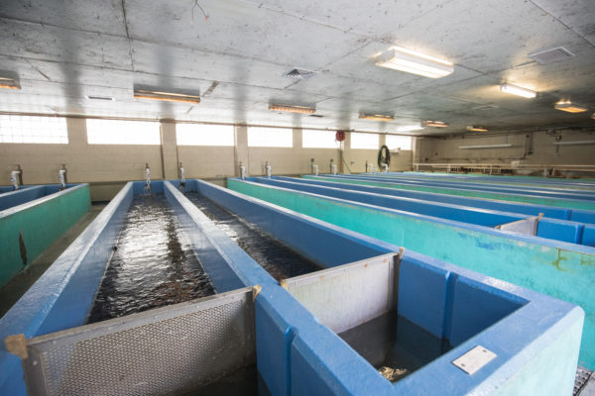
Paint Bank
4-5 Million Eggs
Transfers to other facilities – 90% of brook trout
Brooks/browns/rainbows
100K Trout produced
Stock 27 water bodies, 10 counties

Slide 17
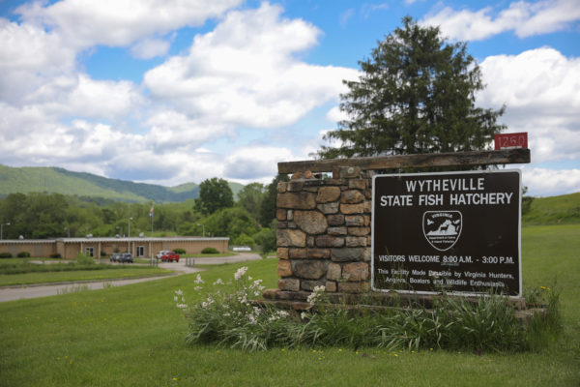

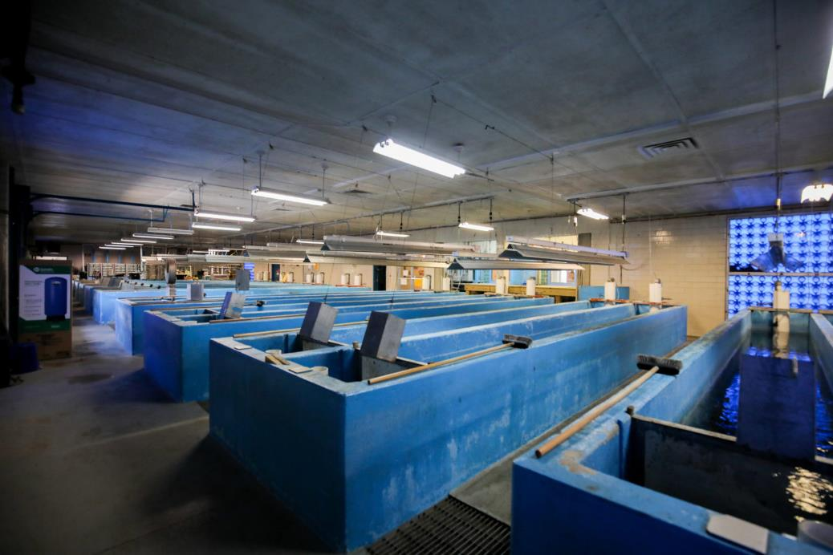
Wytheville
3 Million Eggs
Brown/rainbow only
250K Trout produced
Stock 40 water bodies, 10 counties

Slide 18
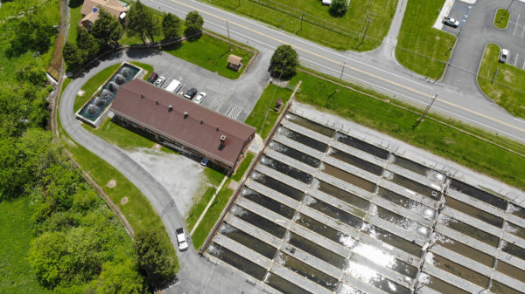
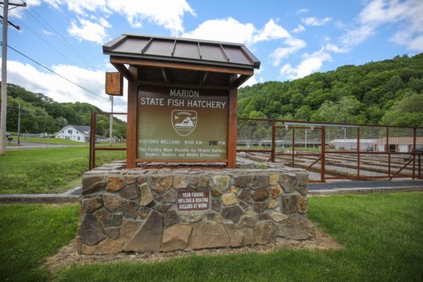
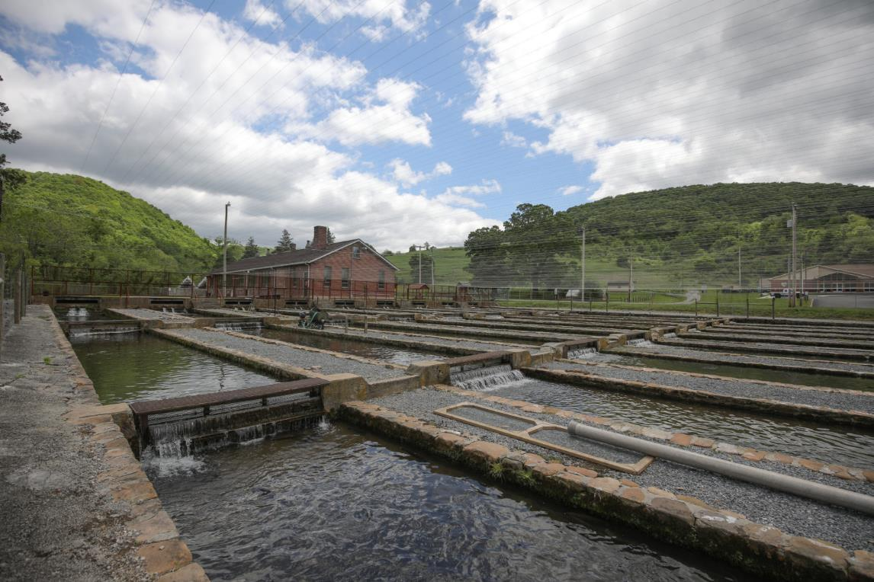
Marion
3 Million Eggs
75% 2n, 25% 3n
400K Trout produced
Stock 38 water bodies, 10 counties

Slide 19
User Base – Stocked Trout Angler – 16% of anglers
47 y/0 White male, high school education, rural
9% Female, 6% people of color, 6% urban
Barrier to fishing -
1) Work commitments
2) Crowding
3) Cost
Performance –
Highest – 1) Information on regulations
2) Info on where to fish
Lowest – 1) Stocking warmwater fish
2) working with private landowners to provide access

Slide 20
Stocked Trout Management Plan (2016-2025)
Comprehensive plan for managing stocked trout
Participants: 11 Anglers, DWR Biologists, CPOs, Hatchery Staff
Issues Identified:
1) Announcement of stockings
2) Angler recruitment and retention
3) Funding and administration
4) Ecosystem effects
5) Recreational opportunities

Slide 21
Approaches:
1) Youth-Only Stocked Waters – 8 Waters – April 1 – June 15
2) Pre-Announced Waters – 12 Waters
3) Special Regs
a) 9” minimum-10 waters
b) 16” minimum/2 per day – 6 waters
c) 20” minimum/1 per day/fly only-2 waters
d) Catch and Release only – 24 waters
4) Delayed Harvest – 15 waters
5) Fee Fishing Areas – 3 waters
6) Stocked Waters - ~100 – Class A (8 stockings), Class B (5 stockings), and Class C (3 stockings)

Slide 22
Questions?

